Slide 1
Hello world!

Slide 2
Outline
In this presentation, we will:
Describe programs
Define programming languages
Look at our first program: Hello world!
Introduce:
Integrated development environments
On-line compilers
Describe the steps of compiling a program

Slide 3
What is a program?
To start, programs gives instructions to a processor to take data (numbers, text, or more generally, information) and perform some operations on (or processes) that data to solve a problem
Initially, the result will be displayed on a screen
Program
Data
Processor
Output
Displayed on the computer monitor
Hard-coded into the source code

Slide 4
What is a program?
By the end of this week,
we will get data from a simple input device: the keyboard
Definition: a console is the combination of a keyboard and screen
Program
Data
Processor
Output
Input
Keyboard

Slide 5
What is a program?
By the middle of the course,
we will access from and store data in files stored within a file system
External storage
A file system
on a hard-disk drive or solid-state drive
Program
Data
Processor
Output
Input

Slide 6
What is a program?
In upper years,
you will investigate embedded systems that are much simpler
External storage
Program
Sensors
Processor
Actuators
Reads information about
the external environment
Activate mechanical and electro-
mechanical devices to respond

Slide 7
What is a program?
In general, a program gives instructions to:
Receives input
Communicates with other devices
Reads and stores data in external storage
Produces output
File systems or databases on
Hard-disk drives
Solid-state drives
Floppy drives
Optical drives
Tape drives
The Cloud
External storage
Program
Keyboards
Mouse
Microphone
Image scanner
Camera
Sensors
Input
Processor
Output
Monitors
Printers
Speakers
Actuators
Through:
- Expansion bus
- Internet
- Bluetooth
- CAN bus
Devices

Slide 8
What is a program?
A simplified model:
A program provides instructions for the processor to communicate with devices to retrieve, process, store and send data
Program
Processor
Devices

Slide 9
Why learn to program?
Why learn programming?
Programming is a systematic means of giving instructions to perform a task
If you are in electrical engineering, we have authored a web site to try to help you understand why the material in this course is relevant:
Why learn programming for electrical-engineering students?
https://ece.uwaterloo.ca/~ece150/Why_programming_for_EE/

Slide 10
Executing programs
When you execute/open/run/launch an application, your computer, laptop or smart phone begins executing instructions
These instructions are coded using a binary encoding:
0 V or 5 V or 0s and 1s
The set of all possible instructions defines a machine language
These are difficult to read:
01100100 0011 0110 0101001000101010
01001110 0101 0011 0011100010001011
10001101 1010 0110 0000000000000000

Slide 11
Programming languages
A programming language is a human readable means of specifying the operations a computer is to perform
Programming languages are used to author source code
This source code is compiled and translated into machine instructions
The resulting instructions can then be executed
Note that some programming languages are interpreted
Thus, C++ will be very different from Python or Maple or Matlab
Programming languages are restricted to the characters that appear on a standard keyboard
These are derived from ascii
The American Standard Code for Information Interchange

Slide 12
Programming languages
All of programming falls under the domain of mathematics
The Cheriton School of Computer Science is within the Faculty of Math
We cannot use mathematical notation in programming languages, and thus we must use other means of describing our intentions
Expression | Representation in C++
2(x + y) | 2*(x + y)
 | (n*n*n)/3
 | 0.5*9.8*s*s + v0*s
sin(x) | sin(x)
|x| | abs(x)
 | sqrt(x)

Slide 13
Our first program
Comments allow for the programmer
to add commentary in English
– these are not part of the program
#include <iostream>
// Function declarations
int main();
// Function definitions
int main() {
// Display this text to the console
std::cout << "Hello world!" << std::endl;
return 0;
}

Slide 14
Our first program
There are three approaches we can take to authoring, compiling, executing and testing this code:
Using an Integrated Development Environment (ide)
We will use Eclipse in the laboratories
Using an on-line compiler such as https://repl.it/
Using a text editor (vi) and a command-line compiler (gcc)
On-line compilers, however:
May not always be available
Become increasingly useless for larger projects

Slide 15
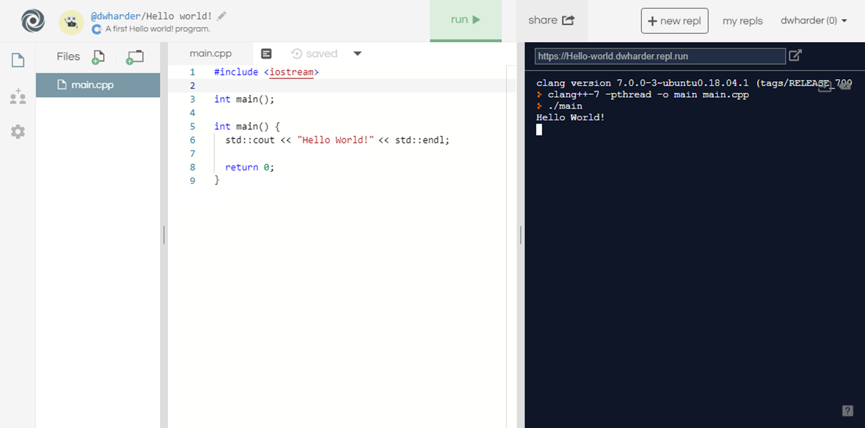
Our first program

Slide 16
Our first program
When you select the Run button, text is printed to the console output
Question: What is happening behind the scene?

Slide 17
Steps in generating an executable program
The program undergoes the following four steps in order to create an executable program that you can run
Step 1: Creating the program using a programming language, and writing it using an editor
Program Code

Slide 18
Steps in generating an executable program
The program undergoes the following four steps in order to create an executable program that you can run
Step 1: Creating the program using a programming language, and writing it using an editor
Step 2: Compiling the program into machine-language code
Program Code
Compiler

Slide 19
Steps in generating an executable program
The program undergoes the following four steps in order to create an executable program that you can run
Step 1: Creating the program using a programming language, and writing it using an editor
Step 2: Compiling the program into machine-language code
Step 3: Linking together the program with other helper programs into a single executable program
E.g., printing to the screen
Program Code
Compiler
Linker

Slide 20
Steps in generating an executable program
The program undergoes the following four steps in order to create an executable program that you can run
Step 1: Creating the program using a programming language, and writing it using an editor
Step 2: Compiling the program into machine-language code
Step 3: Linking together the program with other helper programs into a single executable program
E.g., printing to the screen
Step 4: Executing the program
Program Code
Compiler
Linker
Executable program

Slide 21
Summary
In this presentation, you now
Understand what a program is
Have an overview of how computers executing instructions
These are encoded in binary: 0s and 1s
Understand that programming languages allow us to define programs using a human-readable interface
The program must be compiled into an executable and run
Have written your first program: the ubiquitous Hello world!
Saw this output on https://repl.it
The first lab includes installing the Eclipse ide
You are not required to use Eclipse, but it is the only ide that is supported
Understand the steps of compilation

Slide 22
References
[1] https://en.wikipedia.org/wiki/APL_(programming_language)

Slide 23
Acknowledgments
Proof read by Dr. Thomas McConkey

Slide 24
Colophon
These slides were prepared using the Georgia typeface. Mathematical equations use Times New Roman, and source code is presented using Consolas.
The photographs of lilacs in bloom appearing on the title slide and accenting the top of each other slide were taken at the Royal Botanical Gardens on May 27, 2018 by Douglas Wilhelm Harder. Please see
https://www.rbg.ca/
for more information.

Slide 25
Disclaimer
These slides are provided for the ece 150 Fundamentals of Programming course taught at the University of Waterloo. The material in it reflects the authors’ best judgment in light of the information available to them at the time of preparation. Any reliance on these course slides by any party for any other purpose are the responsibility of such parties. The authors accept no responsibility for damages, if any, suffered by any party as a result of decisions made or actions based on these course slides for any other purpose than that for which it was intended.

